Slide 1
OSIRIS-REx: Investigating Statistical Uncertainties in Remotely Sensed Images
Vivian Morrison
Mentors: Dante Lauretta, Carina Johnson, Dani DellaGiustina, Theodore Kareta
Arizona Space Grant Symposium – Tempe, Session C: Planetary Science
April 13, 2019

Slide 2
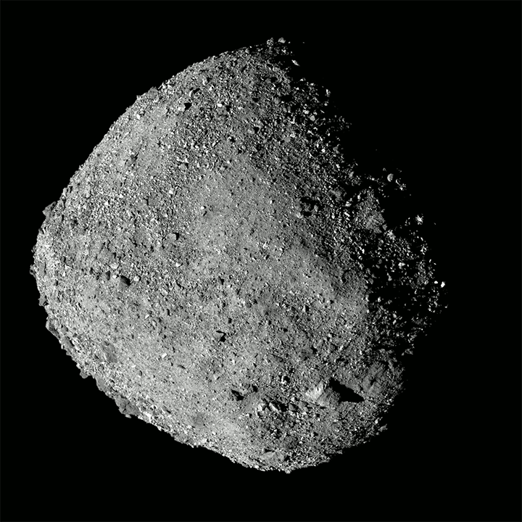
Introduction
NASA’s OSIRIS-REx mission – Asteroid Bennu
Currently in 5th flyby, nearing sampling phase
Bennu’s complex surface texture creates a higher necessity for well constrained boulder identification.
How can we identify errors introduced by remote sensing techniques?

Slide 3
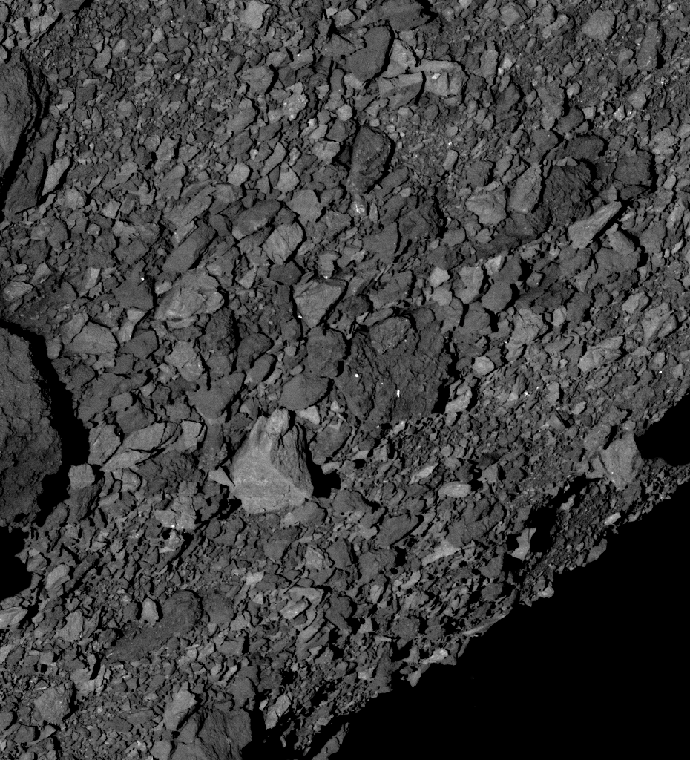
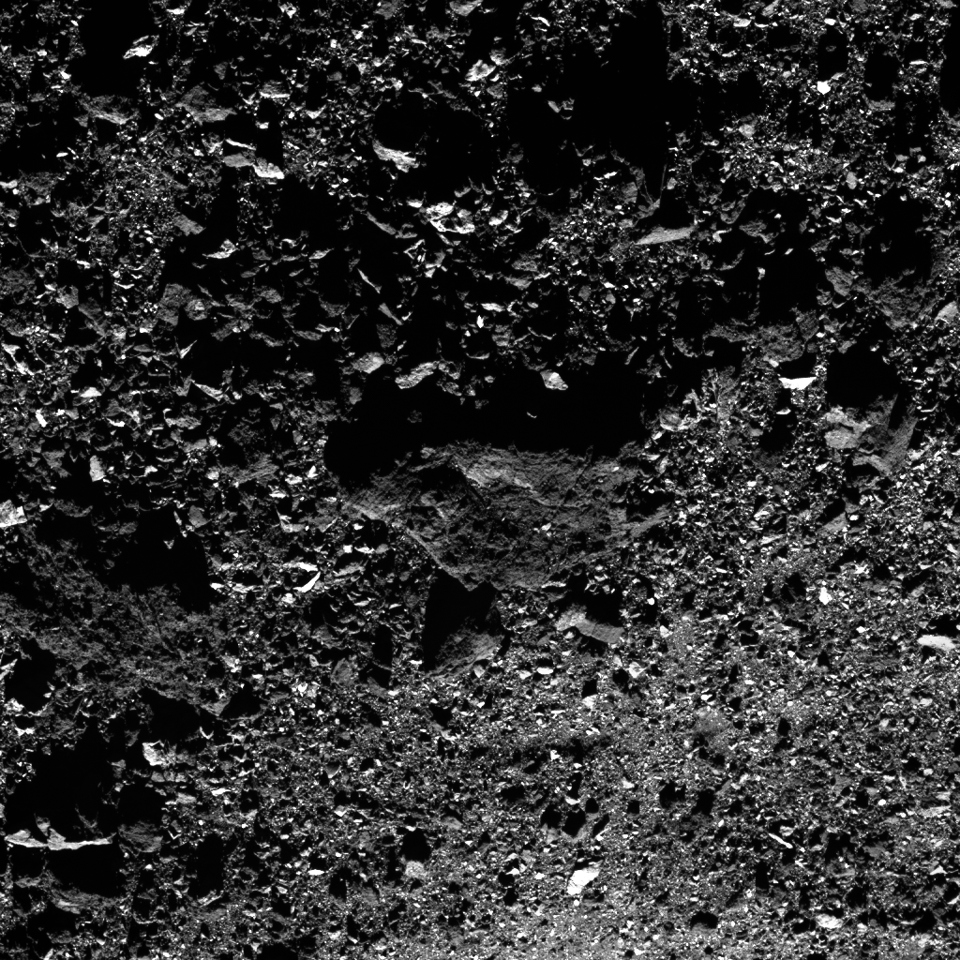

Slide 4
Ground Truth Assessment
Remotely Sensed Images
Collected data of an object outside our reach
Calibration Interpretation
Analysis
Ground Truth Measurements
Simulated data collected for comparative purposes

Slide 5
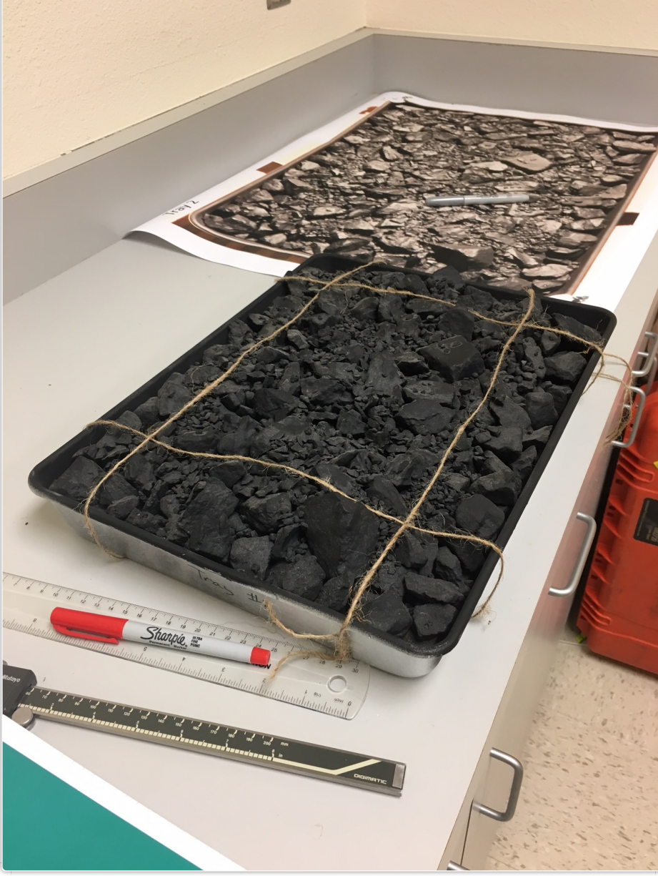
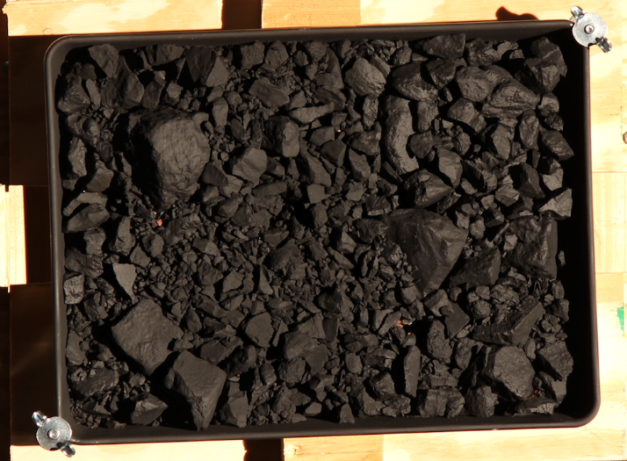
Rock Trays
Simulated rock trays created by the Image Process Working Group (IPWG)
Sizes and distribution of rocks are consistent with those seen from Bennu images
Imaged at known illumination conditions on Bennu

Slide 6
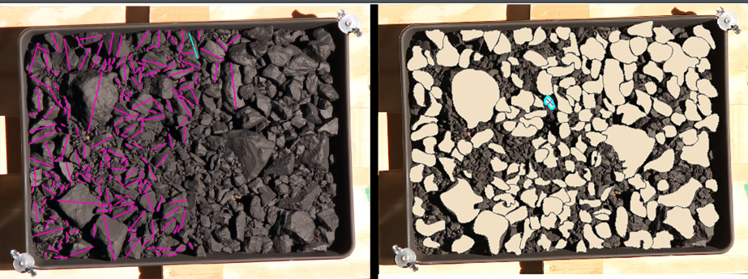
In Situ vs. GIS
Comparative Methods
Truth measurements taken by caliper instruments
Remote measurements through ArcMap/GIS
Determining biases:
How are the discrepancies between data sets being introduced?
To what extent are these biases controllable?
How can we use this going forward?

Slide 7
GIS Processing
Associate measurements to corresponding rock number and input to database
Assign labels to rocks and collect varying measurements on shape and length (pixel)
Apply conversion factor to database and quantify length (mm) in remotely sensed image
Determine conversion factor (pixel to mm)

Slide 8
Source of errors
Natural properties
Processing errors
Irregularly shaped rocks
Rock pile error
Dark surface textures
Certain illumination conditions
Movement distortion
Wrongly associated rock ID number
Measurement errors
Overestimation /Underestimation
Differences in perception (i.e., where to measure length)

Slide 9
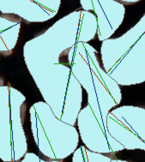
Perception error
Individual determination of where to measure length on an object can create subjective biases
Irregularly shaped rocks are associated with an increase in measurement error
Irregularly shaped rocks, Tray 4

Slide 10
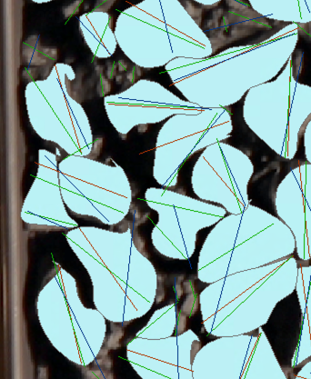
Rock pile error
Surface distribution of rocks can lead to error when determining length of rocks that are partially covered
Additionally creates ID association error in database
Rock cluster, Tray 2

Slide 11
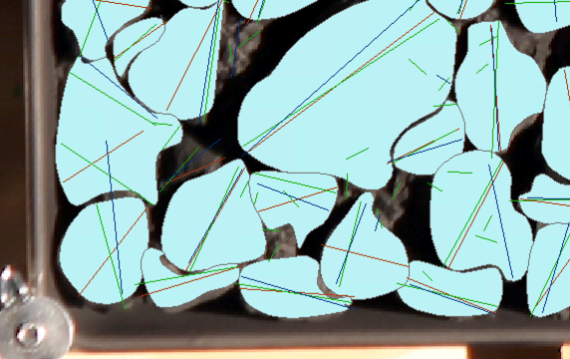
Movement distortion
Varying steadiness of the imaging unit can lead to discrepancies within data and pixel determination
Issues with pixel determination can create much larger errors within database
Distortion in photos of trays

Slide 12
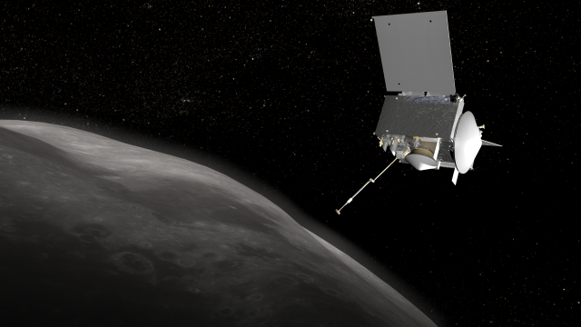
Future research
Furthered research on unidentified sources of error
Developing new code and applying procedural solutions
Usage throughout OSIRIS-REx mission

Slide 13

Acknowledgements
Mentors: Dante Lauretta, Carina Johnson, Dani DellaGiustina, Theodore Kareta
Space Grant Manager: Michelle Coe
Image Processing Working Group (IPWG)
Lunar Planetary Lab

Slide 14
Thank you!

